Slide 1
Predicting the severity of accidents in France - 2005 to 2016
CS-513 : Knowledge Discovery & Data Mining
Fall 2020
Presented by:
Prajwal Prakash
Manasa Geemarahalli Prakash
Devangi Rajput

Slide 2



The Team
Prajwal Prakash Devangi Rajput
Manasa
Geemarahalli Prakash

Slide 3
Agenda
Introduction
Roadmap
Dataset Description
Attribute Details
Exploratory Data Analysis
ML Models
Comparison
Conclusion

Slide 4
Introduction

Slide 5
Overview
Every year, road accidents cause thousands of deaths. We strongly believe that what we learnt in KDD can be used for good, That's why we decided to make this contribution.
Risk varies widely from customer to customer, and a deep understanding of different risk factors helps predict the likelihood and cost of insurance claims.
Many factors contribute to the frequency and severity of accidents including how, where and under what conditions people drive, as well as what they are driving.
Insurance covers people’s bodily injury or death for which the insured is responsible.
GOAL: This project predicts the severity of injury based on various characteristics, users, places and vehicles.

Slide 6
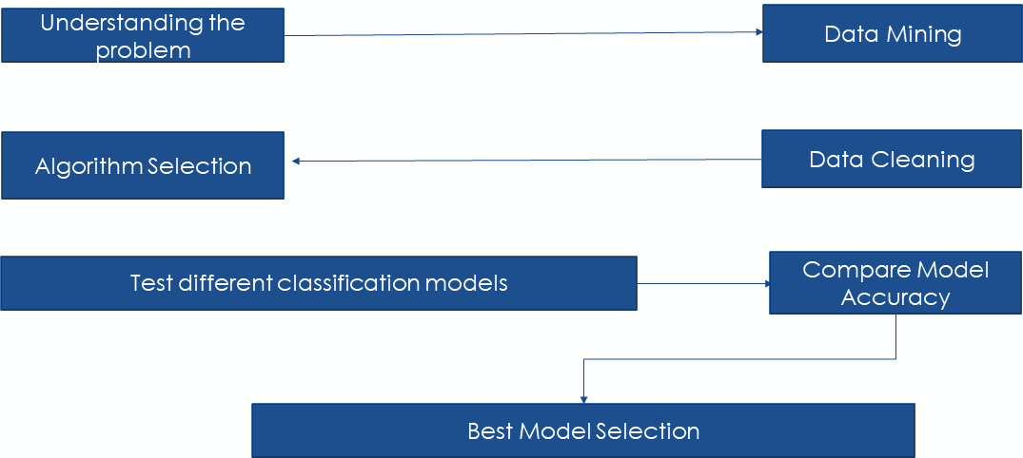
Road Map

Slide 7
Dataset Description
The dataset contains about 1-million data entries of the accidents that happened in france between 2005 -2016
The dataset consists of 4 different files as mentioned below:
characteristics.csv
places.csv
users.csv
vehicles.csv
Kaggle link: https://www.kaggle.com/ahmedlahlou/accidents-in-france-from-2005-to-2016

Slide 8
Attribute Details
CARACTERISTICS:(15 Attributes)

Slide 9
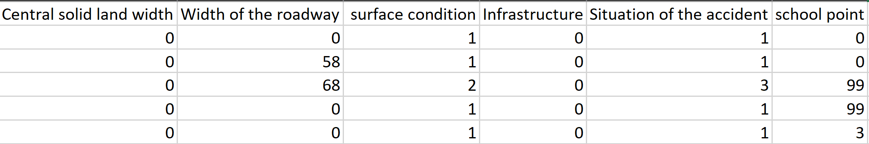
Attribute Details
Places:(18 Attributes)

Slide 10
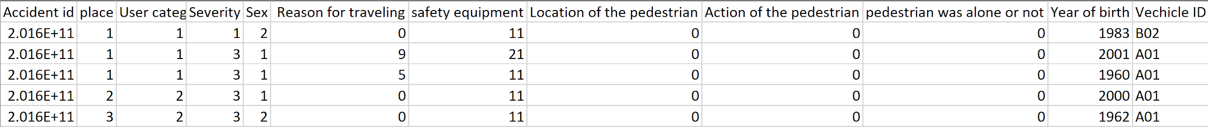
Attribute details
Users:(12 Attributes)

Slide 11
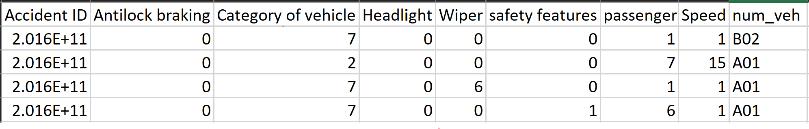
Attribute details
Vehicles:(9 Attributes)

Slide 12
Exploratory Data Analysis

Slide 13
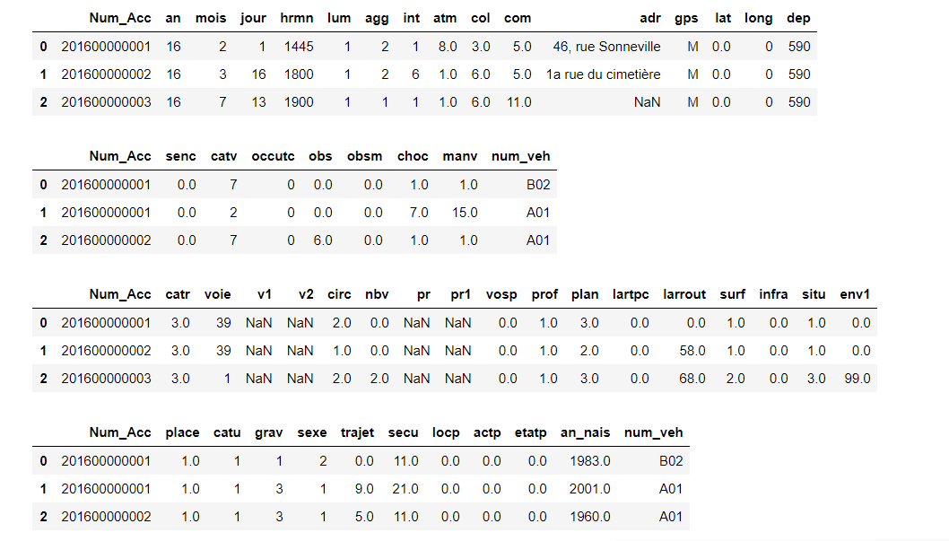
Exploratory Data Analysis
Data Cleaning
1: Merging Datasets: Characterisitcs.csv , Places.csv, Users.csv, Vehicles.csv

Slide 14
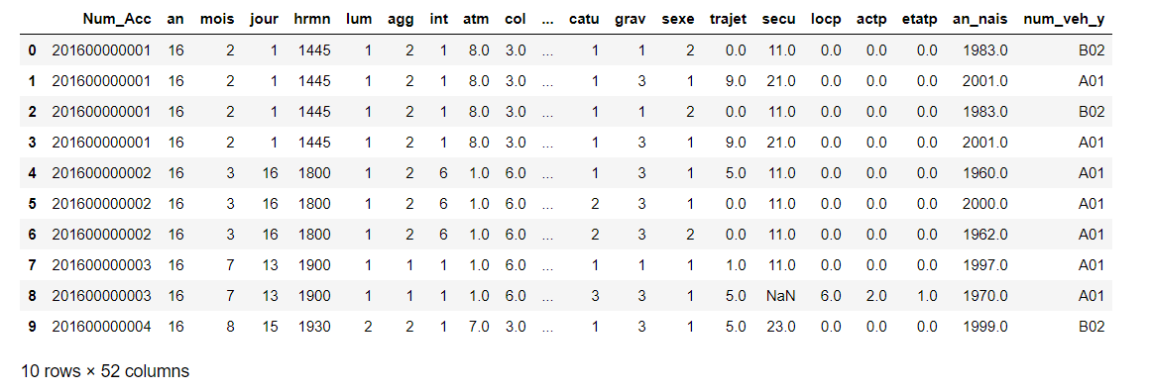
Exploratory data analysis
After Merging

Slide 15
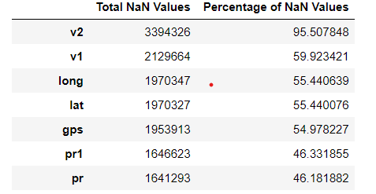
Exploratory data analysis
2. Data Cleaning: Handling missing values

Slide 16
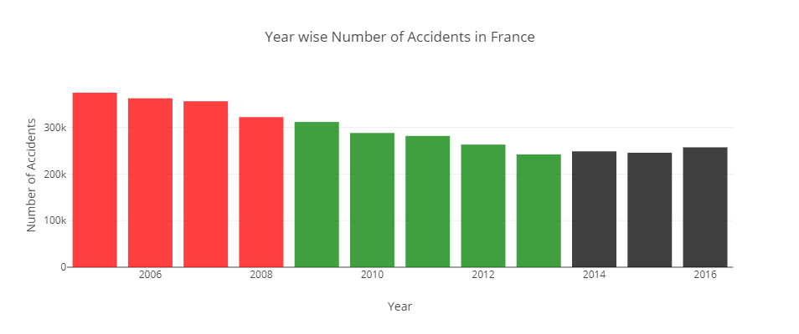
Exploratory data analysis
3. Is the number of accidents per year decreasing ?
Number of accidents in France have steadily decreased from 2005 to 2013, but an increasing trend is observed from 2013 to 2016.
In this dataset, 2005 had the largest number of accidents equal to 374561.

Slide 17
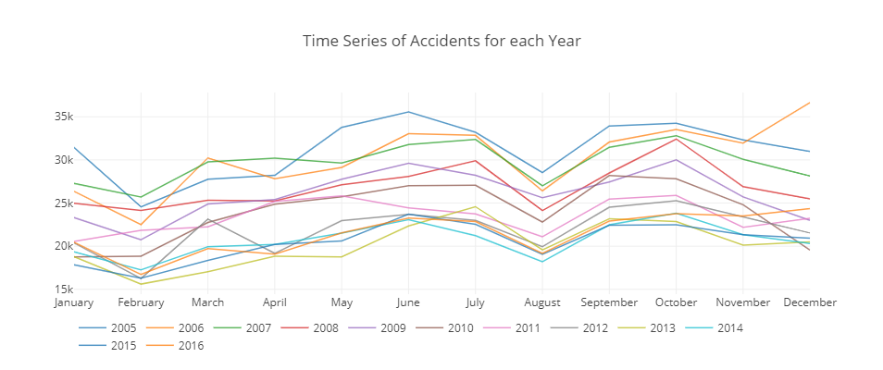
Exploratory data analysis
4. Plotting the time series of accidents for each year
A sharp rise is observed in the months of June, July, September and October.
Sharp drops are observed in February and August.
December, 2006 has the highest number of accidents at 36,648.
February, 2013 has the lowest number of accidents at 15,605.

Slide 18
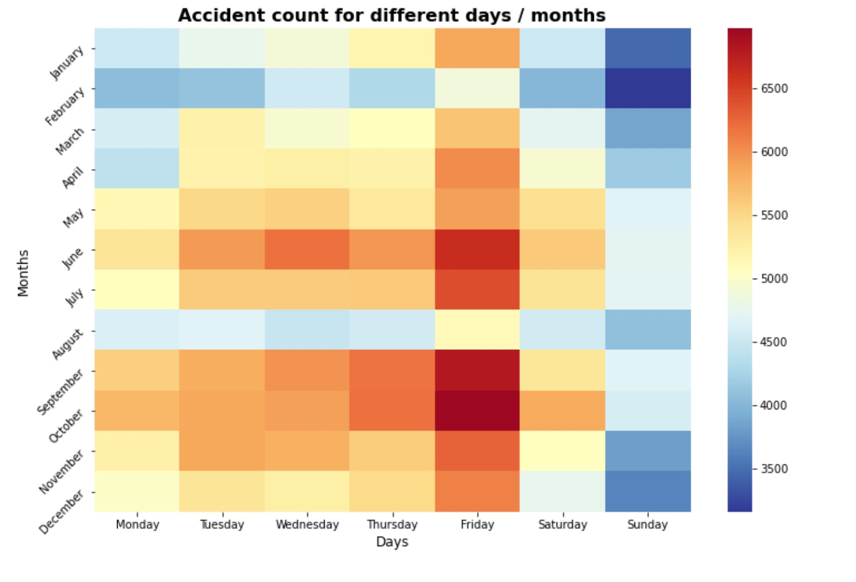
Exploratory data analysis
5. What number of Accidents happened on different days of months?
We observed that Fridays of October are the highest number of accidents.
Sundays of February were observed to have the least number of accidents.

Slide 19
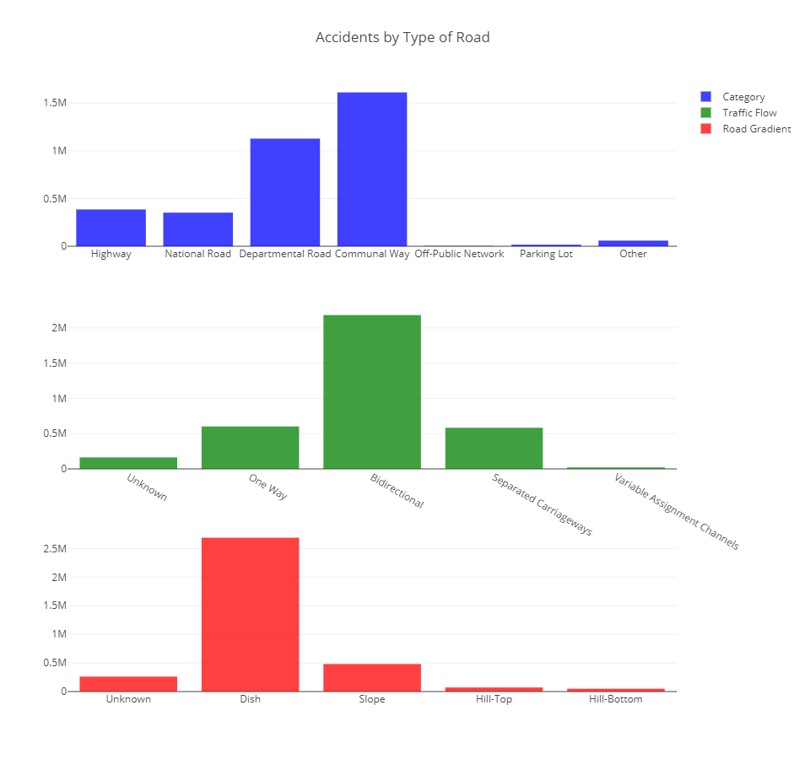
Exploratory data analysis
5. Which types of roads are high-risk ?
Communal Ways and Departmental Roads are riskiest with 1.6 million and 1.1 million accidents each.
Bi-directional Roads are by far the riskiest with over 2.1 million accidents

Slide 20
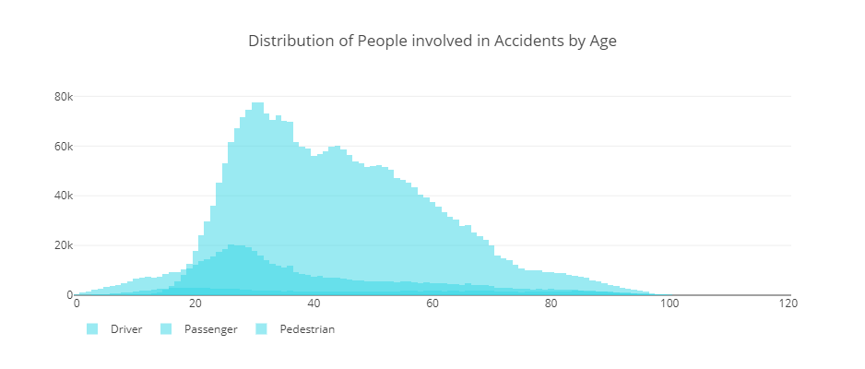
Exploratory data analysis
6. Distribution of People involved in accidents by Age
Maximum Drivers with age range 26- 36 have met with accidents
Maximum Passengers with age range 22 - 32 have met with accidents
Maximum Pedestrians with age range 18- 22 have met with accidents

Slide 21
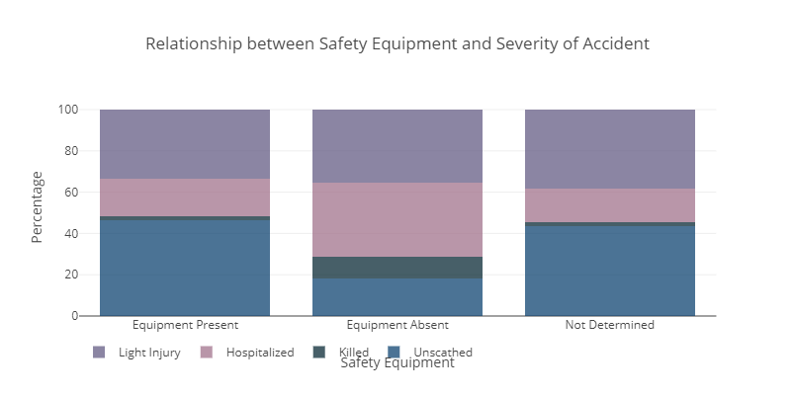
Exploratory data analysis
7. Did Safety Equipment have any impact on severity?
1.9% of the people were killed and 17.8% were hospitalized if Safety Equipment was used.
10.7% of the people were killed and 35.8% were hospitalized if Safety Equipment was not used.

Slide 22
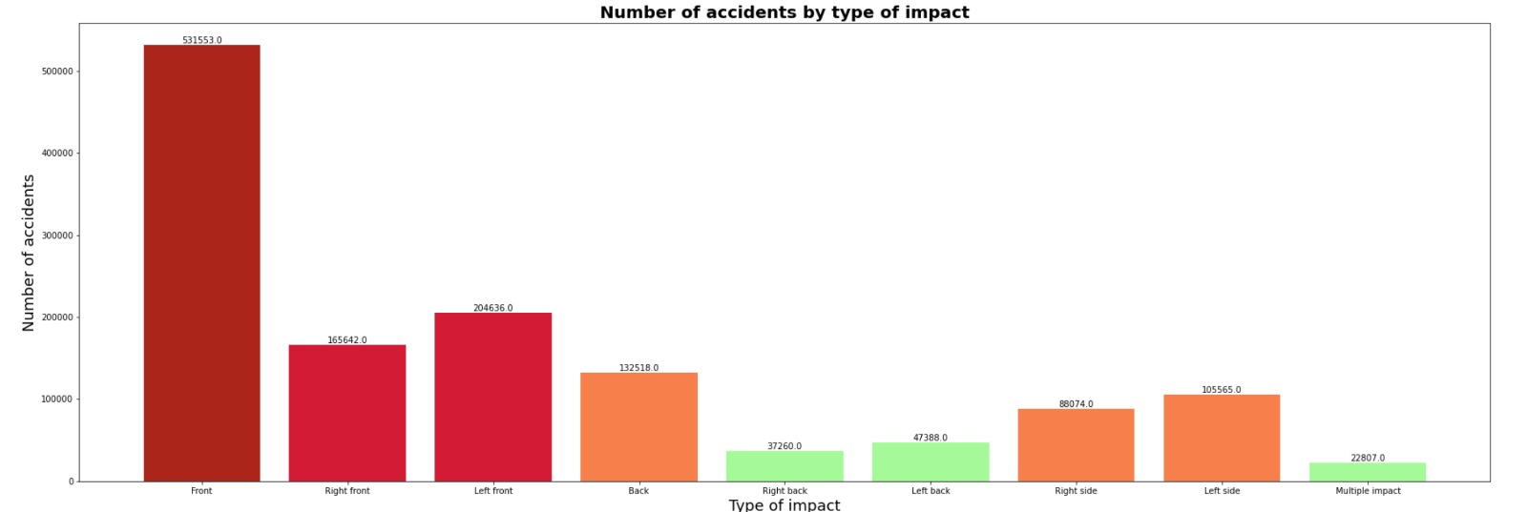
Exploratory data analysis
8. What are the type of collisions in Accidents?

Slide 23
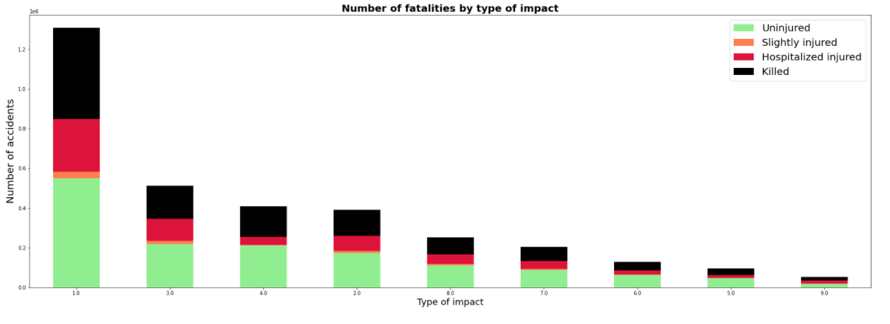
Exploratory data analysis
9. What was severity based on the impact type?
About 36% were killed in frontal impact
About 46% were Uninjured
Only 5% were slightly injured
About 18% were Hospitalised

Slide 24
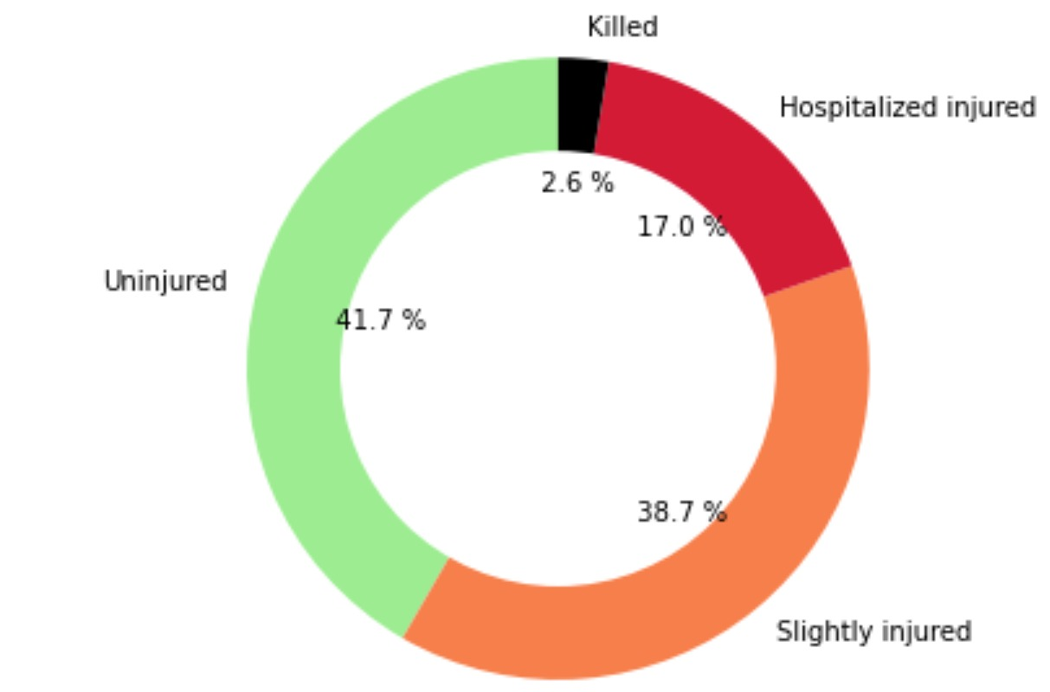
Exploratory data analysis
10. What is the percentage of severity category?
As per 4 categories: 2.6 % Killed, 17.0% Hospitalized, 38.7% Slightly Injured, 41.7% Uninjured.

Slide 25
Machine Learning Models

Slide 26
Models Included
Naive Bayes classifier
Logistic regression
Random Forest
Gradient Boosting
Support Vector Machine(SVM)

Slide 27
Binary Classification

Slide 28
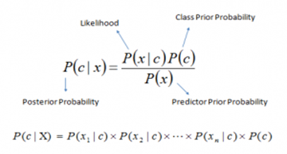
Naive Bayes classifier
It's a classification technique based on Bayes’ theorem with an assumption of independence among predictors. In simple terms, it assumes that the presence of a particular feature in a class is unrelated to the presence of any other feature.

Slide 29
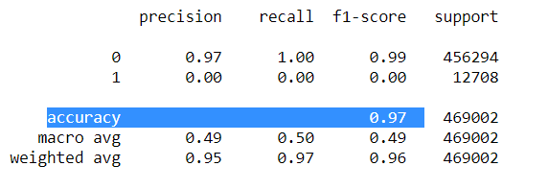
Naive Bayes classifier
Classification Report

Slide 30
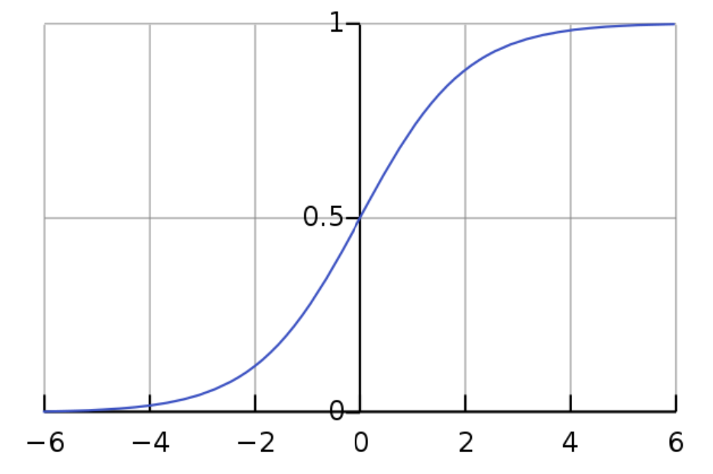
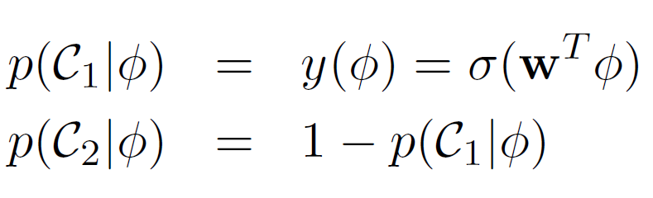
Logistic regression
Logistic regression is a statistical model that in its basic form uses a logistic function to model a binary dependent variable
Logistic regression for 2 class classification:

Slide 31
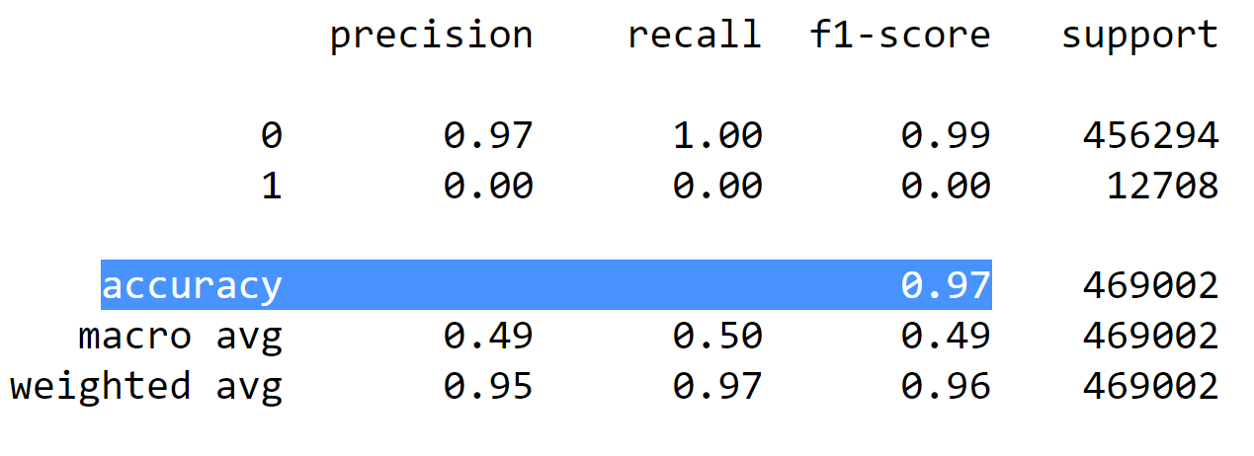
Logistic regression
Classification Report

Slide 32
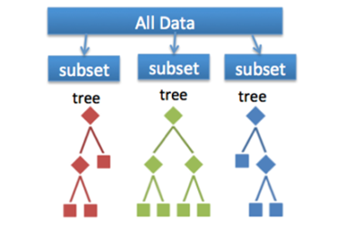
Random Forest
Random forest algorithm is a supervised classification and regression algorithm. This algorithm randomly creates a forest with several trees.
Generally, the more trees in the forest the more robust the forest looks like. Similarly, in the random forest classifier, the higher the number of trees in the forest, greater is the accuracy of the results.

Slide 33
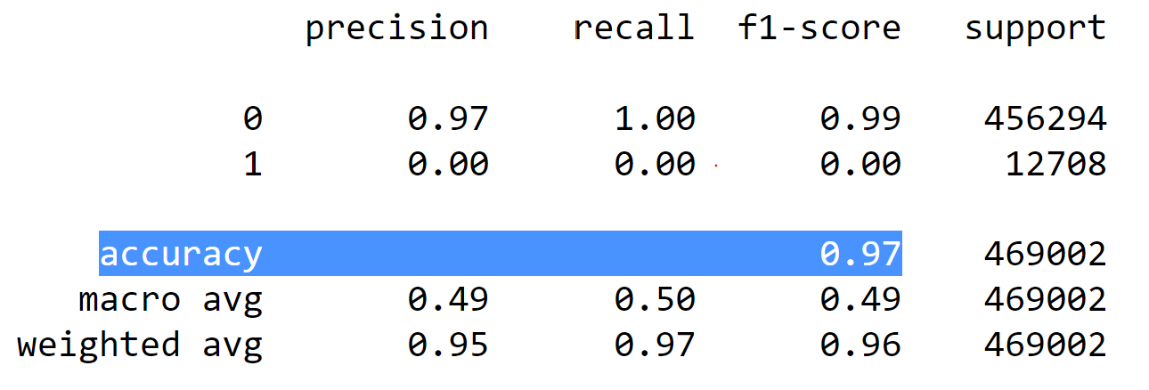
Random Forest
Classification Report

Slide 34
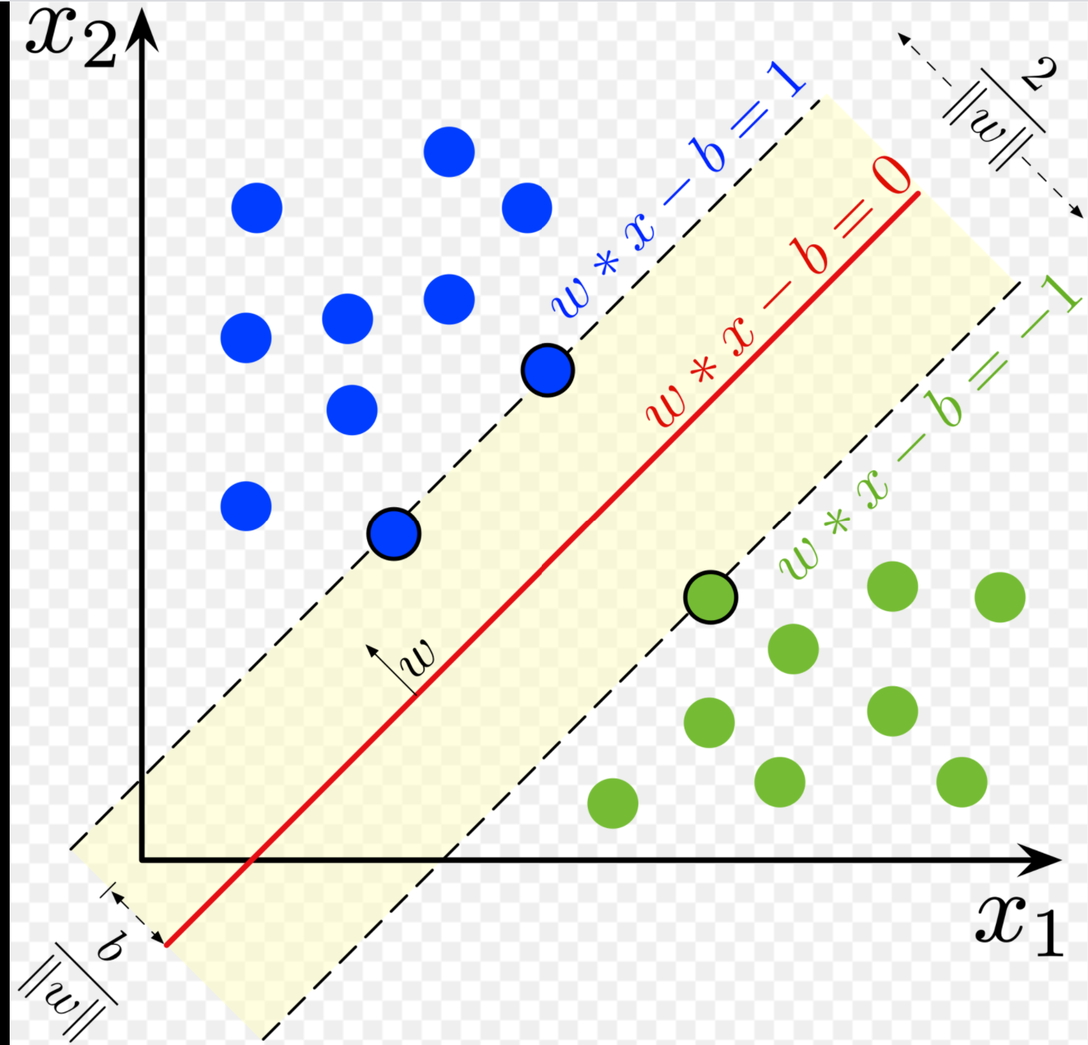
Support Vector Machine(SVM)
SVM is a supervised machine learning algorithm which is mainly used to classify data into different classes
SVM can be used to generate multiple separating hyperplanes such that the data is divided into segments and each segment contains only one kind of data

Slide 35
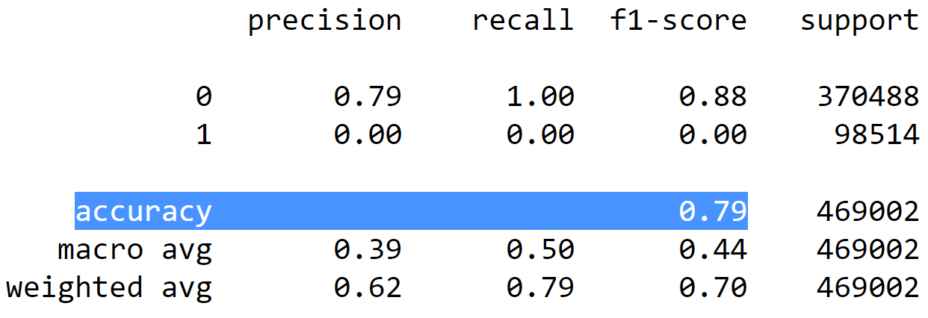
Support Vector Machine(SVM)
Classification Report

Slide 36
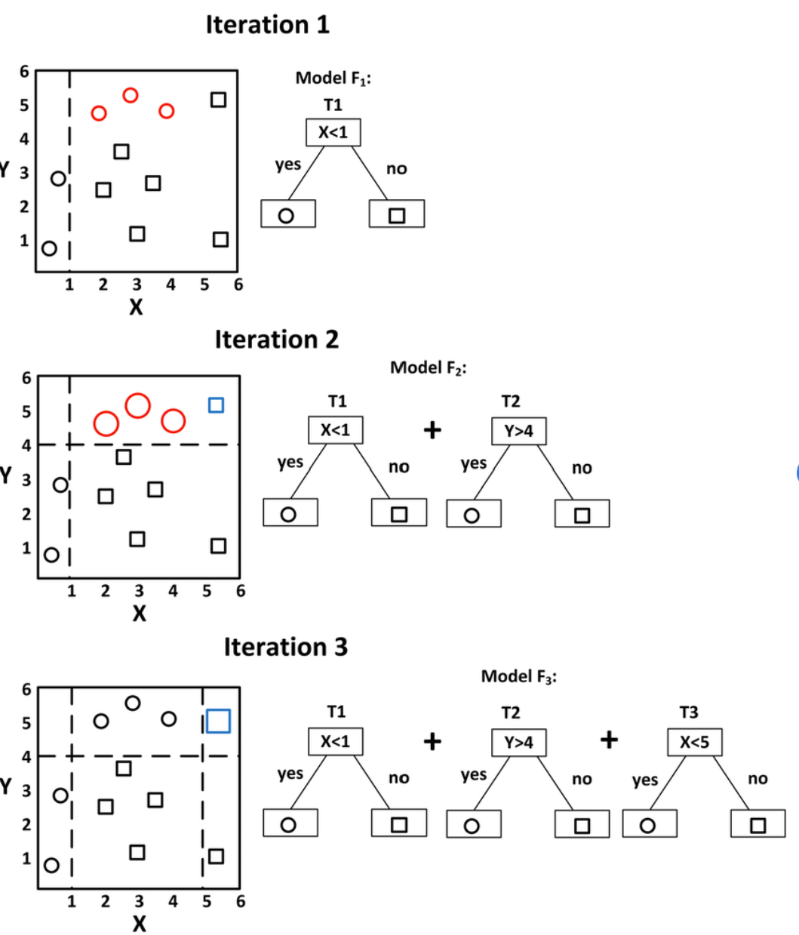
Gradient Boosting
Gradient boosting is a machine learning technique, which produces a prediction model in the form of an ensemble of weak prediction models, typically decision trees.
We need to view this algorithm as iterative functional gradient descent algorithms. That is, algorithms that optimize a cost function over function space by iteratively choosing a function (weak hypothesis) that points in the negative gradient direction.

Slide 37
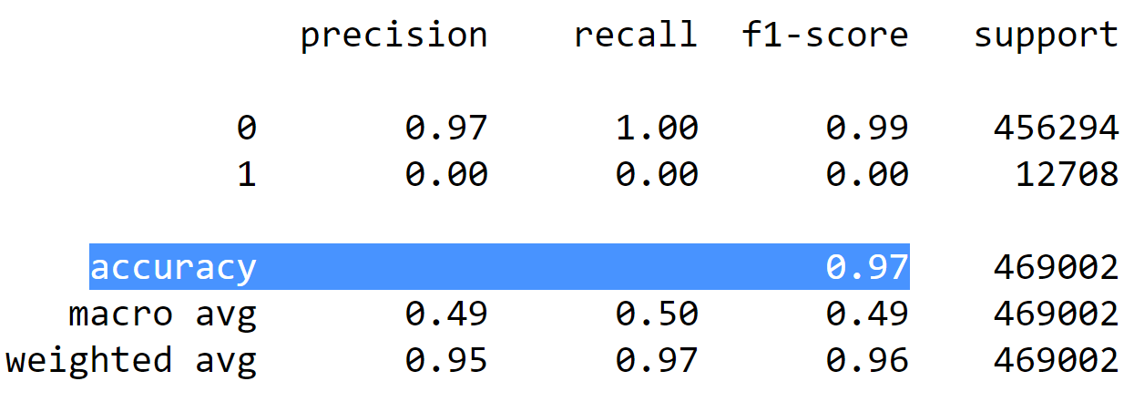
Gradient Boosting
Classification Report

Slide 38
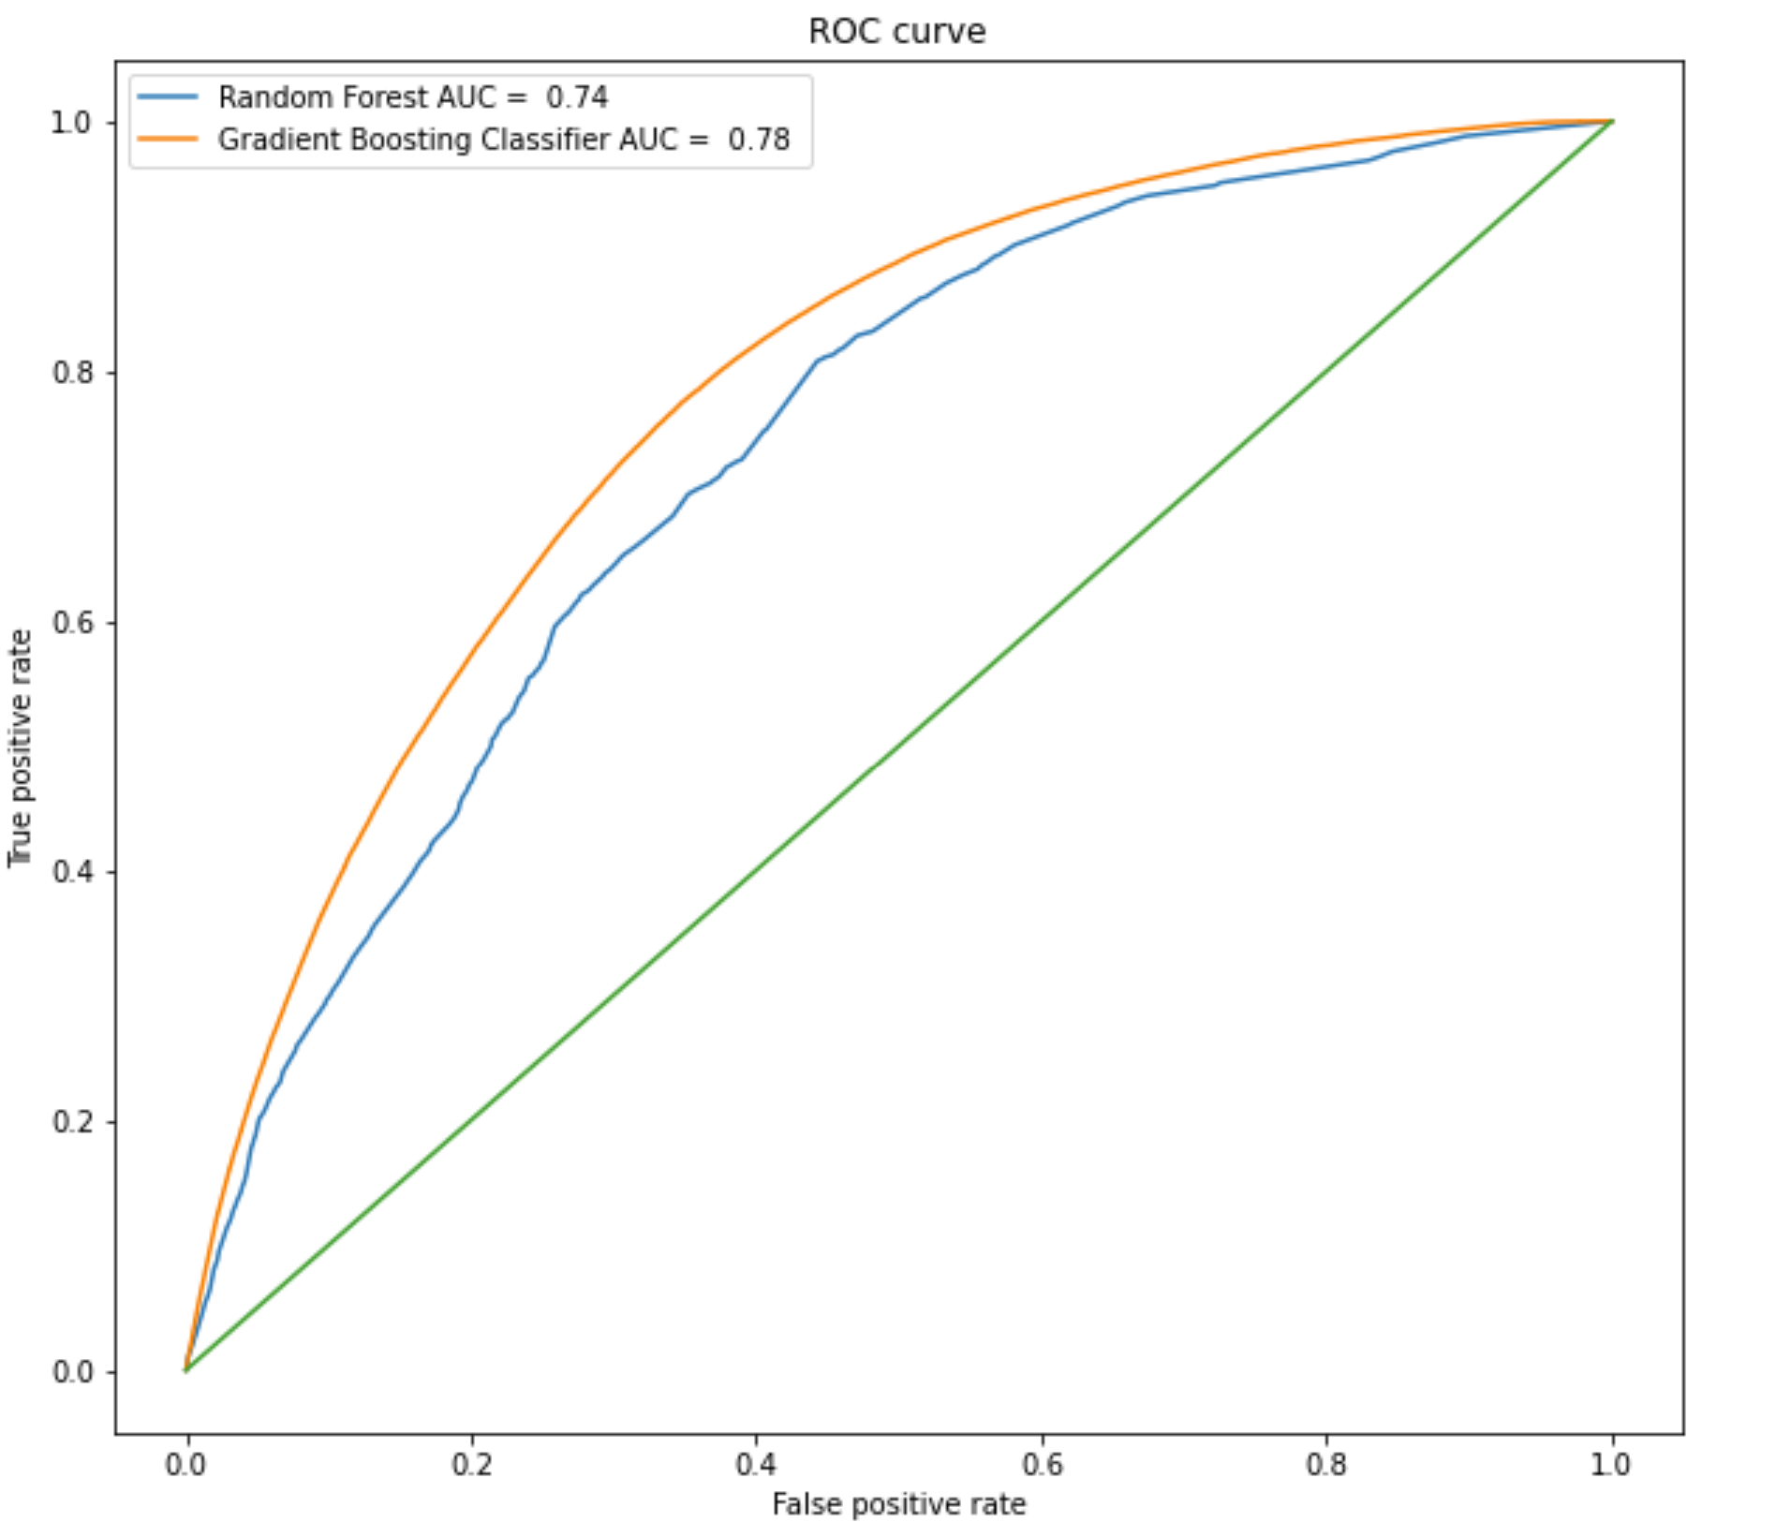
Support Vector Machine(SVM)
receiver operating characteristic curve

Slide 39
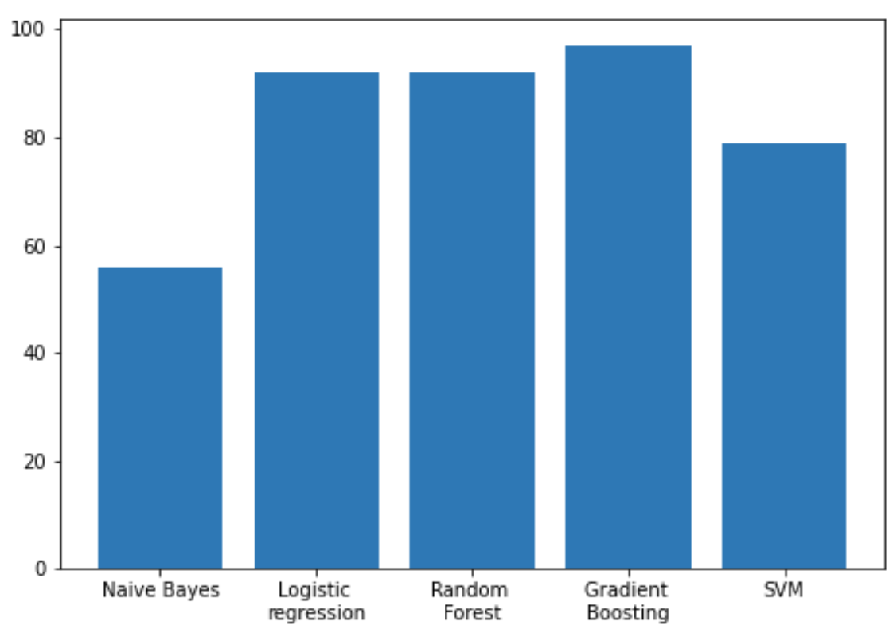
Comparison

Slide 40
Multi-class classification

Slide 41
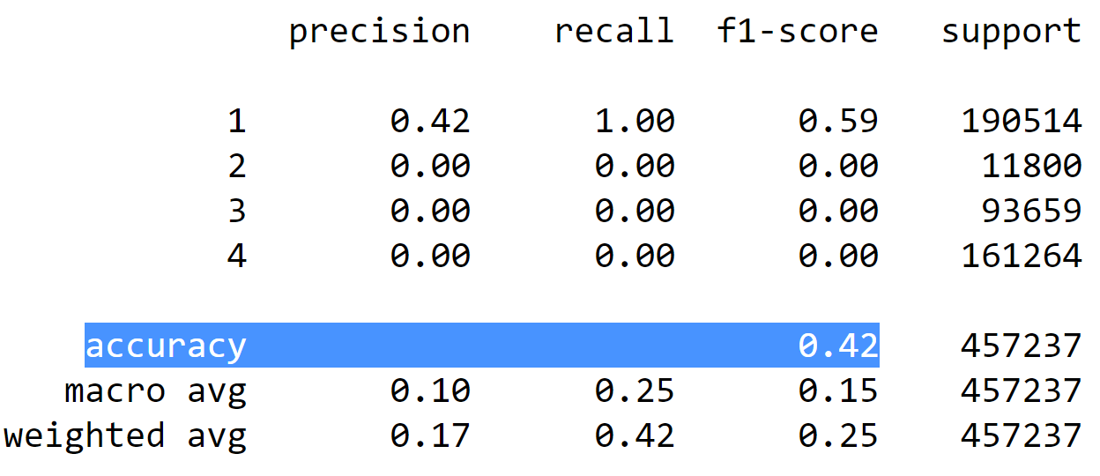
Logistic regression
Classification Report

Slide 42
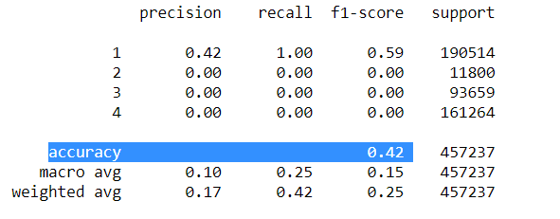
Naive Bayes classifier
Classification Report

Slide 43

Support Vector Machine(SVM)
Classification Report

Slide 44
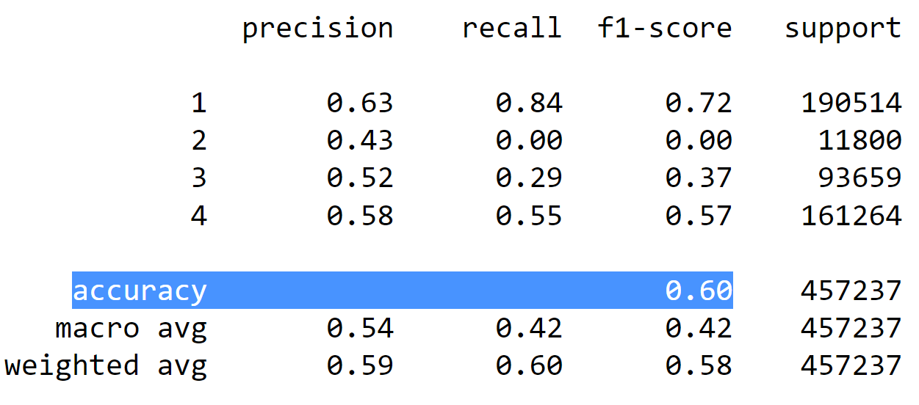
Random Forest
Classification Report

Slide 45
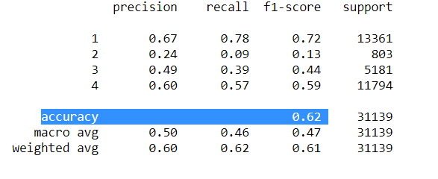
Gradient Boosting
Classification Report

Slide 46
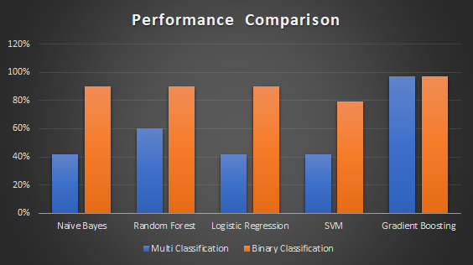

Slide 47
Conclusion
After studying different models on the dataset, it is observed that Gradient boosting provides us the best results with the accuracy of about 97.45%.
Application:
This result can be used by the government to get the insight into various details such as, which type of roads are causing accidents.
Can be used by the insurance companies to follow an adaptive insurance policies.
This data can be used by the policy makers to decide various factors like speed limits on different roads
This data can be used by the automobile companies to better design cars for safety based on the factors like most frequent location of impact during an accident

Slide 48
Thank You

